Slide 1


React Front To Back
React & ES6+

Slide 2
What Is ES6 / ES2015?
6th Major release of ECMAScript
Includes many new features
Most browsers are compatible, some older ones are not
ES6 should be transpired down to ES5 for older browsers
ES7 exists but is nearly identical to ES6

Slide 3
Some ES6 Features We Will Be Using
Classes
Arrow Functions
let & const to declare variables
Template Literals / Template Strings
Destructuring
Import

Slide 4
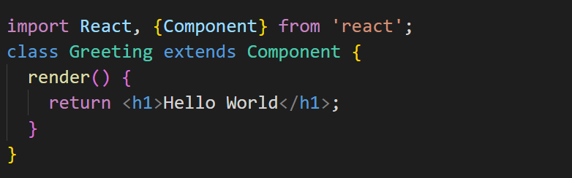
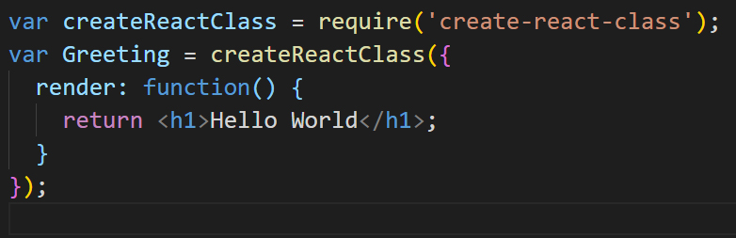
ES6 Imports & Classes
ES6
ES5

Slide 5
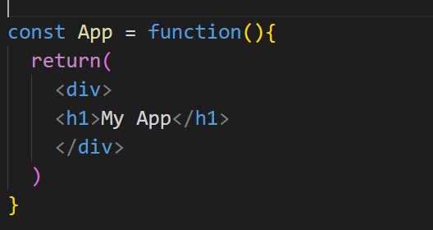
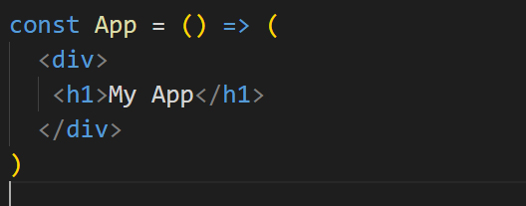
ES6 Arrow Functions
ES5
ES6

Slide 6
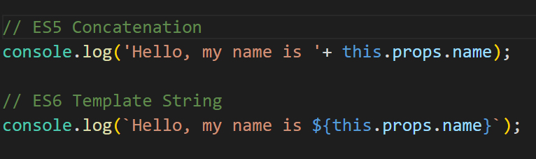
ES6 Template Literals

Slide 7
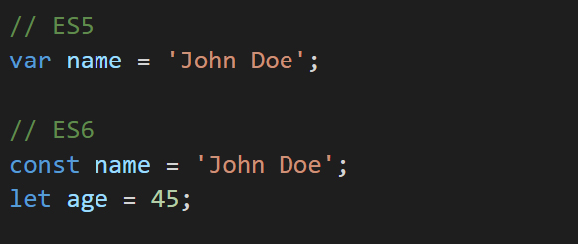
Let & Const

Slide 8


FOLLOW BRAD:
Youtube.com/c/traversymedia
Facebook.com/traversymedia
Twitter.com/traversymedia
Linkedin.com/in/bradtraversy
Thank You
For Watching!
www.traversymedia.com

